Slide 1
The Attack and Defense of Computers
Dr. 許 富 皓

Slide 2
Software and Host Attacks
1

Slide 3
Attack Types
Format string attacks:
Integer overflow and integer sign attacks
Buffer Overflow Attacks:
  Stack Smashing attacks
  Return-into-libc attacks
  Heap overflow attacks
  Function pointer attacks
  .dtors overflow attacks.
  setjump/longjump buffer overflow attacks.

Slide 4
Format String Attacks

Slide 5
Functions with a Variable Number of Parameters (FVNP)
In the C programming language it is possible to declare functions that have a variable number of parameters.
On call, one fixed argument has to tell the function how many arguments there actually are.
Among these kind of functions contained in the C standard library are fprintf(), printf(), sprintf(), snprintf(), vprintf(), vsprintf(), vsnprintf(), setproctitle(), and syslog().

Slide 6
Properties of FVNP
The first parameter of a FVNP is a so called format string.
FVNPs convert all the arguments of possibly varying data types that follow the format string to an output stream.

Slide 7
Functions of a Format String
It tells how to convert the following arguments to a character string (type conversion, width, precision, padding etc.).
It tells how many arguments are actually following the format string.

Slide 8
Example
int i=20;
int j=10;
char *format_string = “The numbers are %d and %d”;
printf(format_string, i, j );
Output to stdout→ The number are 20 and 10
%d → conversion specifier.

Slide 9
Conversion Specifier
Always begin with a % character.
The characters following the %
  designate flags for the format of the output (alignment, width, padding, etc.)
  specify the argument’s type (int, float, char, char *, etc.)
In the output stream every occurrence of a % format indicator is replaced by the value of the corresponding argument (except %% which simply results in a single %.)

Slide 10
Important Conversion Specifier Examples
%d – integer (int) as decimal
%x – integer (int) as hex
%s – string (char *)

Slide 11
How Does The Problem Occur?
e.g.
char user_supplied_input[100];
[…]
printf(user_supplied_input);
or
char user_supplied_input[100];
char some_string[100];
[…]
sprintf(some_string,”%s”,user_supplied_input);
[…]
printf(some_string);
If an user inputs a character string that contains a %x, printf() will expect to find an integer argument behind the format string. But there is no such argument (PS: These kinds of mismatches cannot be recognized at compile time.)

Slide 12
Right Way to Write Previous Statements
printf(“%s”, user_supplied_input);
printf(“%s”,some_string);

Slide 13
Reading Character Strings from (Nearly) Any Location in the Process’ Memory

Slide 14
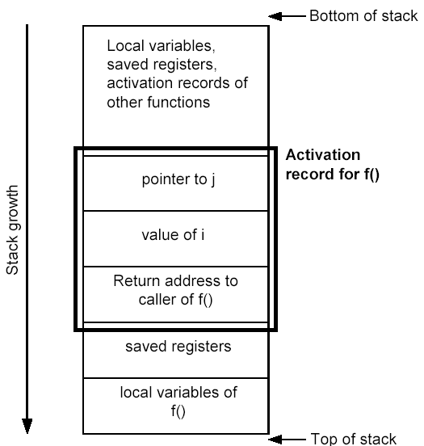
Stack Snapshot: Activation Record for f(int i, int *j)

Slide 15
When Number of Conversion Specifier Is More Than the Number of Other Parameters,
All arguments for the call to printf() are put on the stack. printf() assumes that its activation record contains an arguments on the stack for every conversion specifier in the format string.
For every % it reads the value on the stack in the corresponding location. This way it walks the stack downwards reading would-be arguments from the stack, printing them to the output stream while ignoring whether or not it has already left its actual activation record. There are no boundary checks for activation record.

Slide 16
Read the Contents of the Stack
Under normal conditions the format string contains the information about the size of the actual activation record as pushed on the stack by the caller.
By manipulating the format string an attack is able to make printf() think that its activation record is much larger than it actual is.
That way an attacker is able to read values on the stack if the output stream of printf() is passed back to her/him.

Slide 17
Reading Character Strings from (Nearly) Any Location in the Process’s Memory
If the output of printf() is passed back to the user, the attacker may achieve even more than just reading the contents of the stack: Character strings at more or less arbitrary locations in the text or data segment or on the heap of the process may be read.

Slide 18
Character String Arguments
For character string arguments the activation record only contains a reference (i.e. a pointer) to the string. So in order to display a character string via %s, a corresponding pointer to the string has to be put into the activation record.
e.g.
char dis_str[100]=“Hello World”;
char format_string[5]=“+%s”
printf(format_string,dis_str);
l
e
H
s
%
+
pointer to the string to be displayed
pointer to the format string
return address

Slide 19
Two Important Elements in an Attacking Format String
Assume the format string itself is stored on the stack.
Attackers can NOT change the program code; however, if they can provide the format string to the attacked program, then in order to read a character string from (nearly) any location in the process’s memory by utilizing format string, attackers need to put
  conversion specifier - %s
  address of the string that the attackers are interested
  in the format string.

Slide 20
The Trick
By precisely prepending the %s with enough other conversion specifiers (e.g. %d or %x) printf() can be made into walking the stack downwards reading arguments form the stack just up to the beginning of the format string.
The format string itself starts with some bytes (4 on 32-bit architectures) that constitute the pointer to the memory location containing the character string the attacker is interested in.
When printf() arrives at interpreting the %s, it reads exactly these bytes from the stack taking them as pointer to the string.

Slide 21
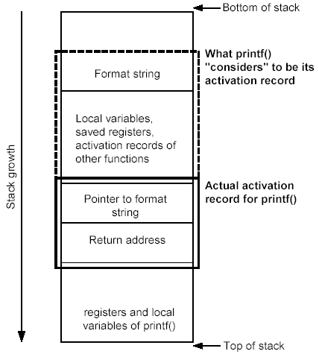

Scenario of a Format Sting Attack
Assume the format string is stored above the printf()’s activation record.
Format string
b bytes
address to the string of interested
b %c
%s
output of printf()

Slide 22
Writing an Integer to (Nearly) Any Location in the Process’ Memory

Slide 23
Conversion Specifiers %n
Definition of %n:
  The number of characters written so far is stored into the integer indicated by the [corresponding] int * (or variant) pointer argument.
For example,
  int i;
  printf(“12345%n”,& i);
  Result → i =5
%n causes printf() to write an integer value to any location in memory.

Slide 24
Assumption
The format string itself is stored somewhere on the stack; therefore, attackers can use the technique introduced in the previous slides in order to control the pointer to the integer.

Slide 25
Example
%c
%c
%c
address to the place an where attacker plan to overwrite
4+b
address to the place an where attacker plan to overwrite
b %c
%n
b
:
:
:
:
pointer to the format string
return address

Slide 26
Targets to Overwrite
important program flags that control access privilege.
return addresses on the stack
internal linkage tables (e.g. ELF GOT or PLT entries)
function pointers
setjmp/longjmp buffers
to force a control flow corruption and jump to
injected code.

Slide 27
Tricks to Avoid Length Format String
Width field of conversion specifiers:
  E.g. %.8x

Slide 28
Integer Overflow
and
Integer Sign Attacks

Slide 29
Signed and Unsigned Integers
Singed integers store either a 1 or 0 in the most significant bit (MSB) of their storage.
  If the MSB is 1, the stored value is negative.
  If the MSB is 0, the value is positive.
Unsigned integers do not utilize this bit, so all unsigned integers are positive.

Slide 30
An Integer Overflow
Integer overflows exist because the values that can be stored within the numeric data type are limited by the size of the data type itself.
For example, a 16-bit data type can only store a maximum value of 32767, whereas a 32-bit data type can store a maximum value of 2147483647 ( here both values are signed integers.)
Therefore, if 60000 is assigned to a 16-bit signed data type. An integer overflow would occur, and the value actually stored within the variable would be -5536.

Slide 31
ISO C99 Standard
According to ISO C99, an integer overflow causes undefined behavior; therefore, each compiler vendor can handle an integer overflow however they choose.
When facing an integer overflow, compiler venders could:
  ignore it. (adopted by most venders)
  attempt to correct the situation.
  abort the program.

Slide 32
Modulo-arithmetic (1)
Modulo-arithmetic defines the formula to decide the value of a numeric data type when placing a large value into a small data type.
The formula looks something like:
stored_value=value%(max_value_for_datatype+1)
Most compiler venders that ignore an integer overflow use modulo-arithmetic to decide the final value of an overflowed data type.

Slide 33
Modulo-arithmetic (2)
Modulo-arithmetic is a fancy way of saying the most significant bytes are discarded up to the size of the data type and the least significant bits are stored.

Slide 34
Example
#include <stdio.h>
int main()
{ long l= 0xdeadbeef;
short s = l;
char c = l;
printf(“long: %x\n”,l);
printf(“short: %x\n”,s);
printf(“char : %x\n”,c);
return(0);
}
long: deadbeef
short:ffffbeef
char: ffffffef

Slide 35
Explanation of the Example
In the example, the most significant bits were discarded, and the values assigned to short and char are what you have left.
Because a short can only store 2 bytes, we only see “beef,” and a char can only hold 1 byte, so we only see “ef.”
The truncation of the data cause the data type to store only part of the full value. This is why our value was -5536 instead of 60000 in previous slides.

Slide 36
Signed Attacks
Signedness bugs occur when an unsigned integer is assigned to a signed integer, or vice versa.

Slide 37
Example
typedef unsigned int size_t;
extern void *memcpy(void *dest, const void *src, size_t n);
static char data[256];
int store_data(char *buf, int len)
{ if (len > 256 )
return -1;
return memcpy(data, buf, len);
}
P.S.: memcpy requires an unsigned integer for the length parameter; therefore, the signed variable len would be promoted to an unsigned integer, lose its negative sign, and could wrap around and become a very large positive number, cause memcpy() to read past the bounds of buf.

Slide 38
Denial of Service (DoS) Attacks
&
Distributed Denial of Service (DDoS) Attacks

Slide 39
DoS/DDoS Attacks
A DoS/DDoS attack is a type of attack technique
  by saturating a victim system with enormous network traffic to the point of unresponsiveness to the legitimate users
  by saturating the links that a victim uses to communicate with other hosts
  by crashing the victim system so that it is no longer available to legitimate users

Slide 40
Categories of DoS/DDoS Attacks
Flood Attack:
  Smurf Flood Attack.
  TCP SYN Flood Attack.
  UDP Flood Attack.
  ICMP Flood Attack.
  DNS Amplification Attack.
  Coremelt Link Flooding.
  Crossfire Attack.
Malformed Packet Attack:
  Ping of Death Attack.
  Chargen Attack.
  TearDrop Attack.
  Land Attack.

Slide 41
Smurf Flood Attacks
An attacker sends forged ICMP echo packets to broadcast addresses of vulnerable networks.
All the systems on these networks reply to the victim with ICMP echo replies.
This attack rapidly exhausts the bandwidth available to the target, effectively denying its services to legitimate users.

Slide 42



1
host 1
2
host 2
host V
3
V
V
V
host 3
V
4
host 4
V
host A

Slide 43
TCP SYN Flood Attacks
Taking advantage of the flaw of TCP three–way handshaking behavior, an attacker makes connection requests aimed at the victim server with packets with unreachable source addresses.
The server is not able to complete the connection requests and, as a result, the victim wastes all of its network resources.
A relatively small flood of bogus packets will tie up memory, CPU, and applications, resulting in shutting down a server .

Slide 44
Countermeasures of TCP SYN Flood Attacks
SYN Cookies.
  Weakness:
    Disable retransmission of SYN/ACK packets, which violates the TCP/IP protocol.
    Calculating the related sequence numbers is a CPU-bound work, which may overload a CPU.

Slide 45
UDP Flood Attacks
UDP is a connectionless protocol and it does not require any connection setup procedure to transfer data.
A UDP Flood Attack is possible when an attacker sends a UDP packet to a random port on the victim system.
  When the victim system receives a UDP packet, it will determine what application is waiting on the destination port.
  When it realizes that there is no application that is waiting on the port, it will generate an ICMP packet of destination unreachable to the forged source address.
  If enough UDP packets are delivered to ports on victim, the system will go down.

Slide 46
ICMP Flood Attacks
An attacker sends a huge number of ICMP echo request packets to a victim and, as a result, the victim cannot respond promptly since the volume of request packets is high and the victim has difficulty in processing all requests and responses rapidly.
The attack will cause the performance degradation or system down.

Slide 47
DNS Amplification Attack _{[niranjan]}
DNS amplification occurs due to the response packet being significantly larger than that of the query.
A DNS query consisting of a 60 byte request can be answered with responses of over 4000 bytes amplifying the response packet by a factor of 60.

Slide 48
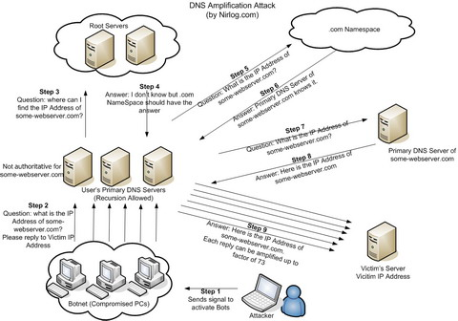
DNS Amplification Attack _{[niranjan]}

Slide 49
Coremelt Attack [Ahren Studer and Adrian Perrig]

Slide 50
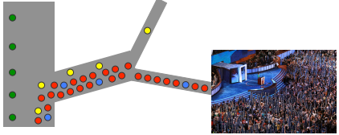
Road Networks _{[Ahren Studer & Adrian Perrig]}
Old flooding attacks are like protestors
Limited capacity near the destination causes congestion.

Slide 51
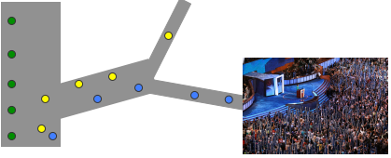
Road Networks _{[Ahren Studer & Adrian Perrig]}
Old flooding attacks are like protestors
After identifying a single source of malicious traffic, an ISP can “pull the plug”

Slide 52
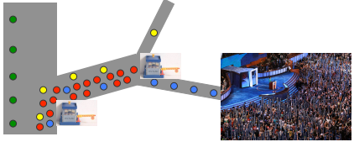
Road Networks _{[Ahren Studer & Adrian Perrig]}
Old flooding attacks are like protestors
With capabilities, legitimate traffic is given preference

Slide 53
The Coremelt Attack _{[Ahren Studer & Adrian Perrig]}
Bots sending traffic to each other
  Such that traffic traverses the target link
Bypasses existing DoS defenses
  Traffic is “wanted” so capabilities are acquired
  No obvious reason to filter; hence, traffic looks legitimate
    Each bot contributes a small amount of traffic

Slide 54
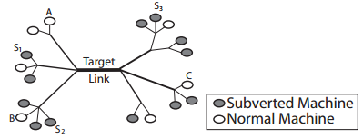
The Coremelt Attack _{[Ahren Studer & Adrian Perrig]}
server

Slide 55
Launching a Coremelt Attack (1) _{[Ahren Studer & Adrian Perrig]}
Select a link in the network as the target link.
Identify what pairs of subverted machines can generate traffic that traverse the target link.
Send traffic between the pairs identified in step 2 to overload the target link

Slide 56
Launching a Coremelt Attack (2) _{[Ahren Studer & Adrian Perrig]}
Rent a well distributed botnet
  With a dense botnet, smaller tributary links will congest first
Discover routes that traverse the target
  Discreet use of traceroute

Slide 57
Crossfire Attack _{[Kang et al.]}

Slide 58
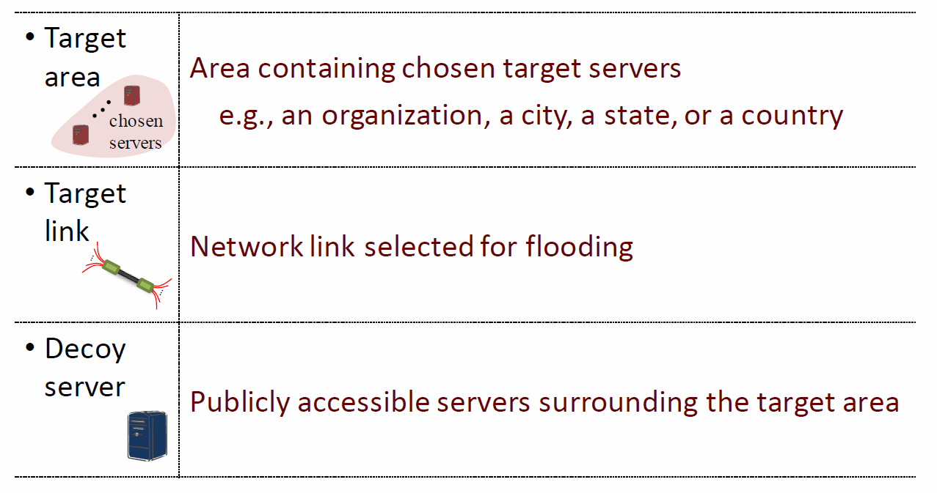
Definitions _{[Kang et al.]}

Slide 59
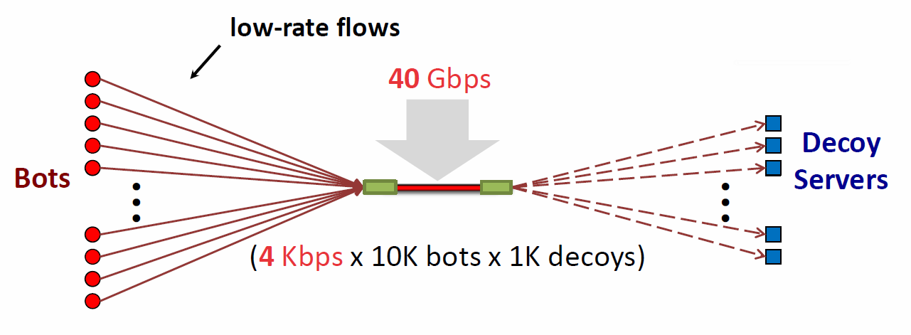
Attack Flows _{[Kang et al.]}
Attack flows => Indistinguishable from legitimate

Slide 60
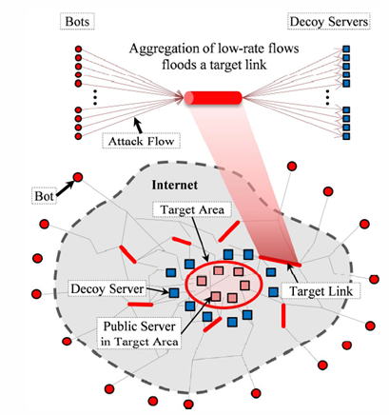
The Crossfire Attack _{[Kang et al.]}

Slide 61
Server Definition _{[Kang et al.]}
Public servers :
  To construct an attack topology centered at target area
Decoy servers:
  To create attack flow

Slide 62
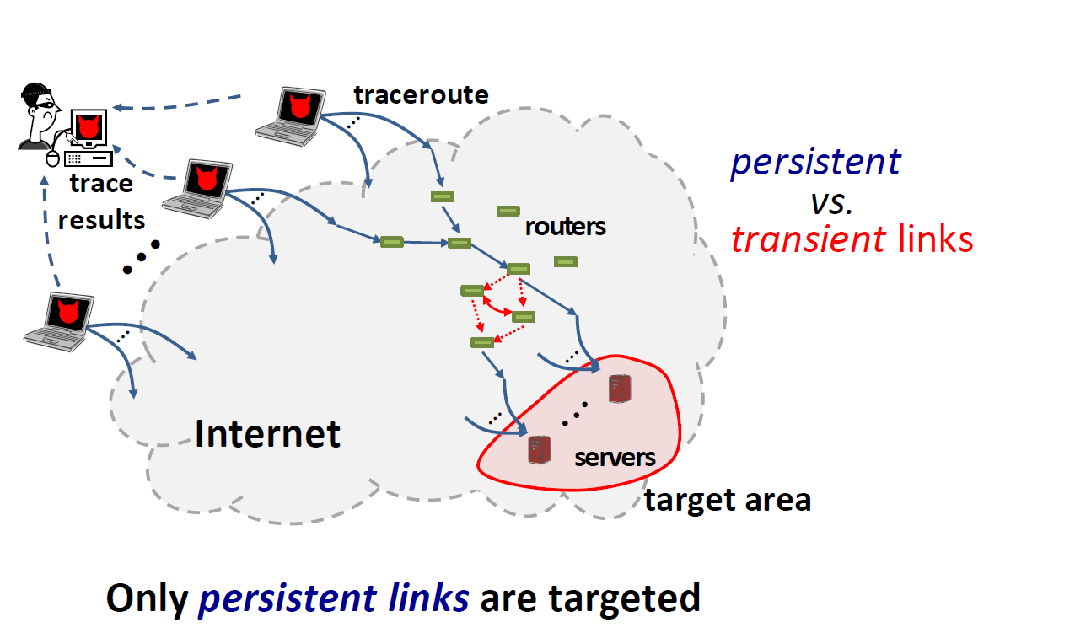
Attack - Step 1 : Link Map Construction _{[Kang et al.]}

Slide 63
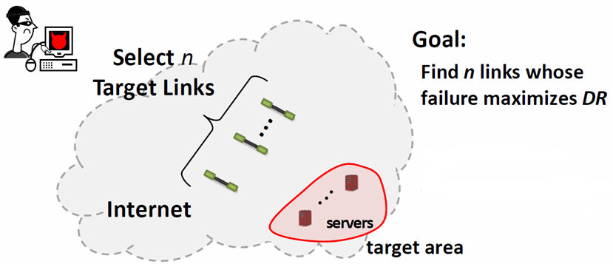
Attack - Step 2 : Attack setup _{[Kang et al.]}
DR: Degradation Ratio

Slide 64
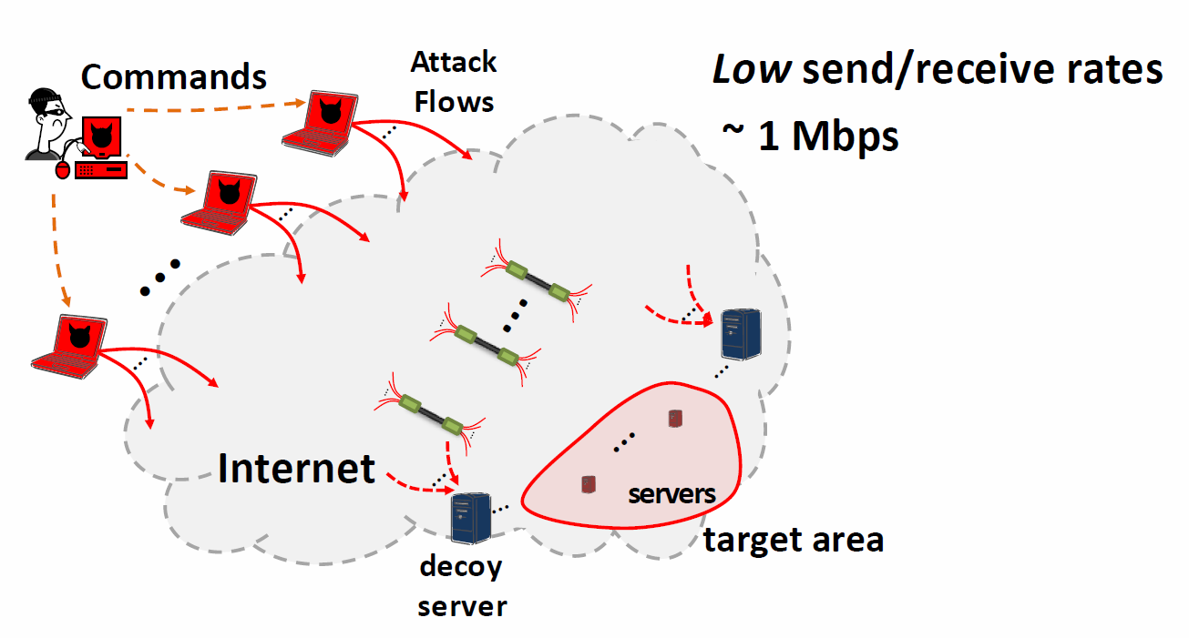
Attack - Step 3 : Bot Coordination _{[Kang et al.]}

Slide 65
DDoS Attacks

Slide 66
Principle of DDoS Attacks
A DDoS attack system has a complicated mechanism and entails an extreme cooperation between systems to maximize its attacking effectiveness.

Slide 67
Command Chains between DDoS Attack Components
The attack systems involved three system components:
  Master (Handler).
  Slave (Agent).
  Victim.
A DDoS attack is possible by the coordination of many systems. To clog up the victim's network with enormous network traffic, the attacker need to use a number of systems as for handlers and agents.
The attacker commands handlers and the handlers control a troop of agents to generate network traffic.

Slide 68
Snatch Attacking Hosts
To make a successful attack, an attacker first needs to have a number of systems to secure a bridgehead, usually large systems with high-speed network connection.
To compromise such systems as many as possible and install DDoS tools on each of them, an attacker must find those systems with various techniques, such as network port scanning, OS fingerprinting, and other known infiltrating techniques.

Slide 69
Hide DDoS Tools
Also, to hide those DDoS tool's presence after installation, the attacker may use other techniques such as
  IP address spoofing
  or
  rootkit
  and so forth.

Slide 70
Prepare Handlers and Agents
The installed DDoS tools turn the compromised systems into attack zombies.
Once the DDoS tools are installed on many compromised systems, the attacker is easy to launch an attack by controlling agents through handlers via commands.
Once an attack begins, the target is not able to handle the tremendous volume of the bogus traffic.

Slide 71
A Simulated Case of DDoS Attack
attacker
master
master
master
slave
slave
slave
slave
slave
slave
slave
slave
victim
victim

Slide 72
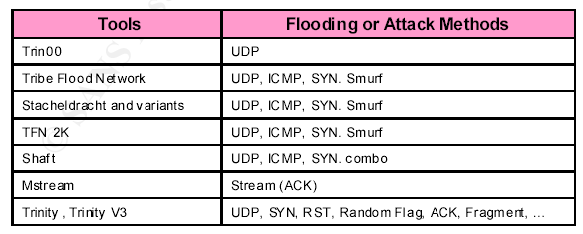
DDoS Tools

Slide 73
Malformed Packet Attack

Slide 74
Ping of Death Attacks
An attacker sends an ICMP ECHO request packet that is much larger than the maximum IP packet size to victim.
Since the received ICMP echo request packet is bigger than the normal IP packet size, the victim cannot reassemble the packets. The OS may be crashed or rebooted as a result.

Slide 75
Chargen Attacks (1) _{[Mathieu Perrin]}
When contacted, chargen (UDP port 19) responds with some random characters (something like all the characters in the alphabet in a row).
  When contacted via UDP, it will respond with a single UDP packet.
  When contacted via TCP, it will
  continue spewing characters until the client closes the connection.

Slide 76
Chargen Attacks (2) _{[Mathieu Perrin]}
An easy attack is 'ping-pong' in which an attacker spoofs a packet between two machines running chargen.
This will cause them to spew characters at each other, slowing the machines down and saturating the network.

Slide 77
port 19
port 19
src IP=I 19 dst IP=V 19
src IP=V 19 dst IP=I 19
host V
host I
src IP=V 19 dst IP=I 19
host A

Slide 78
port 19
port 19
host V
host I
host A

Slide 79
TearDrop Attacks
An attacker sends two fragments that cannot be reassembled properly by manipulating the offset values of packets and cause a reboot or halt of a victim system.
Many other variants such as targa, SYNdrop, Boink, Nestea Bonk, TearDrop2 and NewTear are available.

Slide 80
Land Attacks
An attacker sends a forged packet with the same source and destination IP address. The victim system will be confused and crashed or rebooted.

Slide 81
Countermeasures of DoS/DDoS Attacks
Disable unnecessary network services.
Backtracking the attack paths of attack traffic, then install filters at the most upstream routers to filter out attack traffic as early as possible.

